Slide 1
Unsupervised detection of background and moving cars
Yongning Wu, Xiao Ling

Slide 2
Problem Statement
Background subtraction, also known as Foreground Detection is typically the first step before more in-depth object recognition.
In this simplified setting, we assume that
A fixed camera facing some traffic
Car is the main moving part.

Slide 3
Main Steps
extract data file from video
converge on background
annotate frames

Slide 4
Method
EM algorithm is the main method used to iteratively improve the estimation of unobserved background. We assume there is a background predictor BP.
E-step: for each pixel on each frame, predict the likelihood of background with BP.
M-step: update background estimation by weighted average of all frame pixels.

Slide 5
Background Initialization
A simple version is to take unweighted average of original frames
Can handle most of cases where background pixel occupancy is high
A sophisticated version is to apply an external car predictor which only gives a rough mask of the car
Better initialization and closer to true background

Slide 6
Youtube:
CCTV Full HD 1080p 10Fps Zoom 15X.mp4
https://www.youtube.com/watch?v=7a3BSb281JM
Traffic CCTV Full HD 1080p 10Fps.mp4
https://www.youtube.com/watch?v=xIV8HucebvI

Slide 7
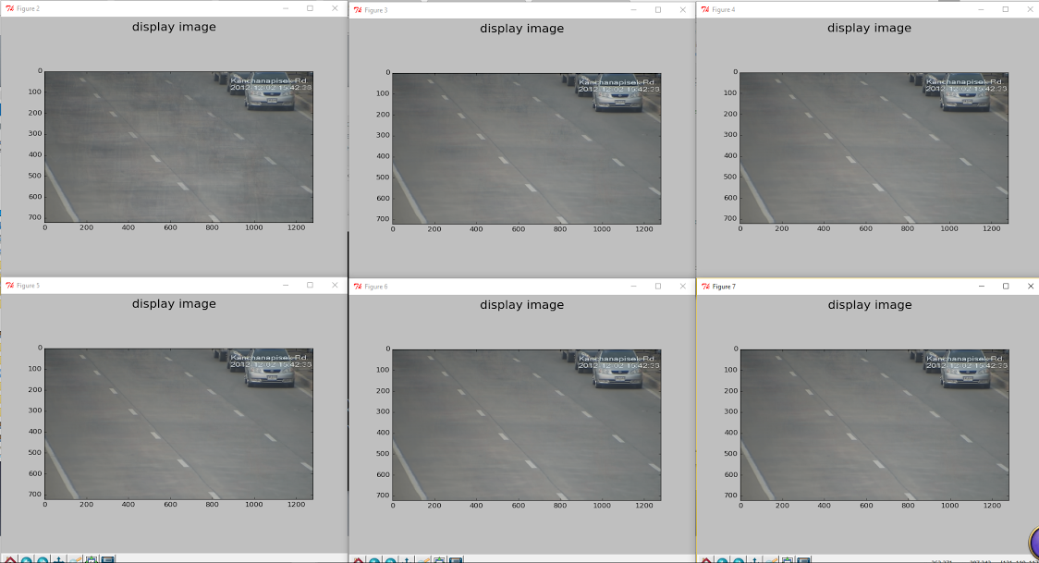

Slide 8
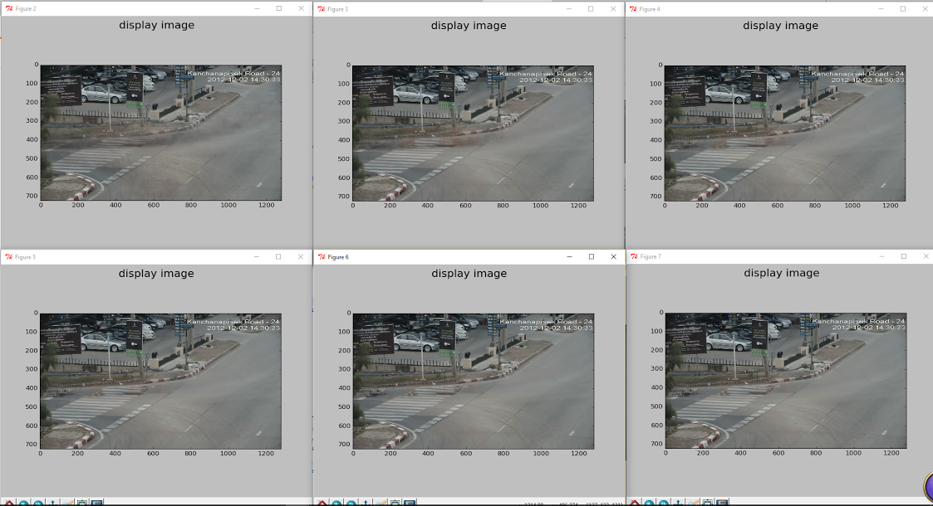

Slide 9
Background Predictor: BP
Use Gaussian density function
Mean is the weighted average of background
Standard deviation starts with high value and tends to decrease with iteration.
The prediction will be smoothed in (x, y) dimension.
[TODO] further smoothed in time dimension

Slide 10
Foreground Annotation
Try to enforce a binary classification on the given frames:
Depends on predictor (sigma in Gaussian), threshold
Smoothing
Show video

Slide 11
Discussion
Pixel level alignment to handle camera shaking
Better prior initialization
Space-temporal smoothing and long time range background update.

